Slide 1
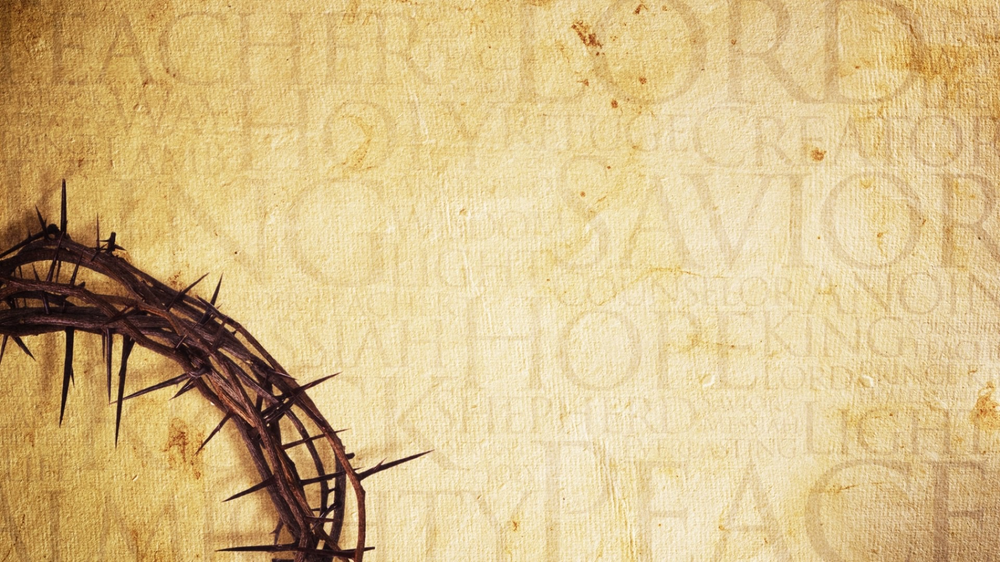
Our True Identity: God’s Image Bearers
Psalm 8:1-6

Slide 2
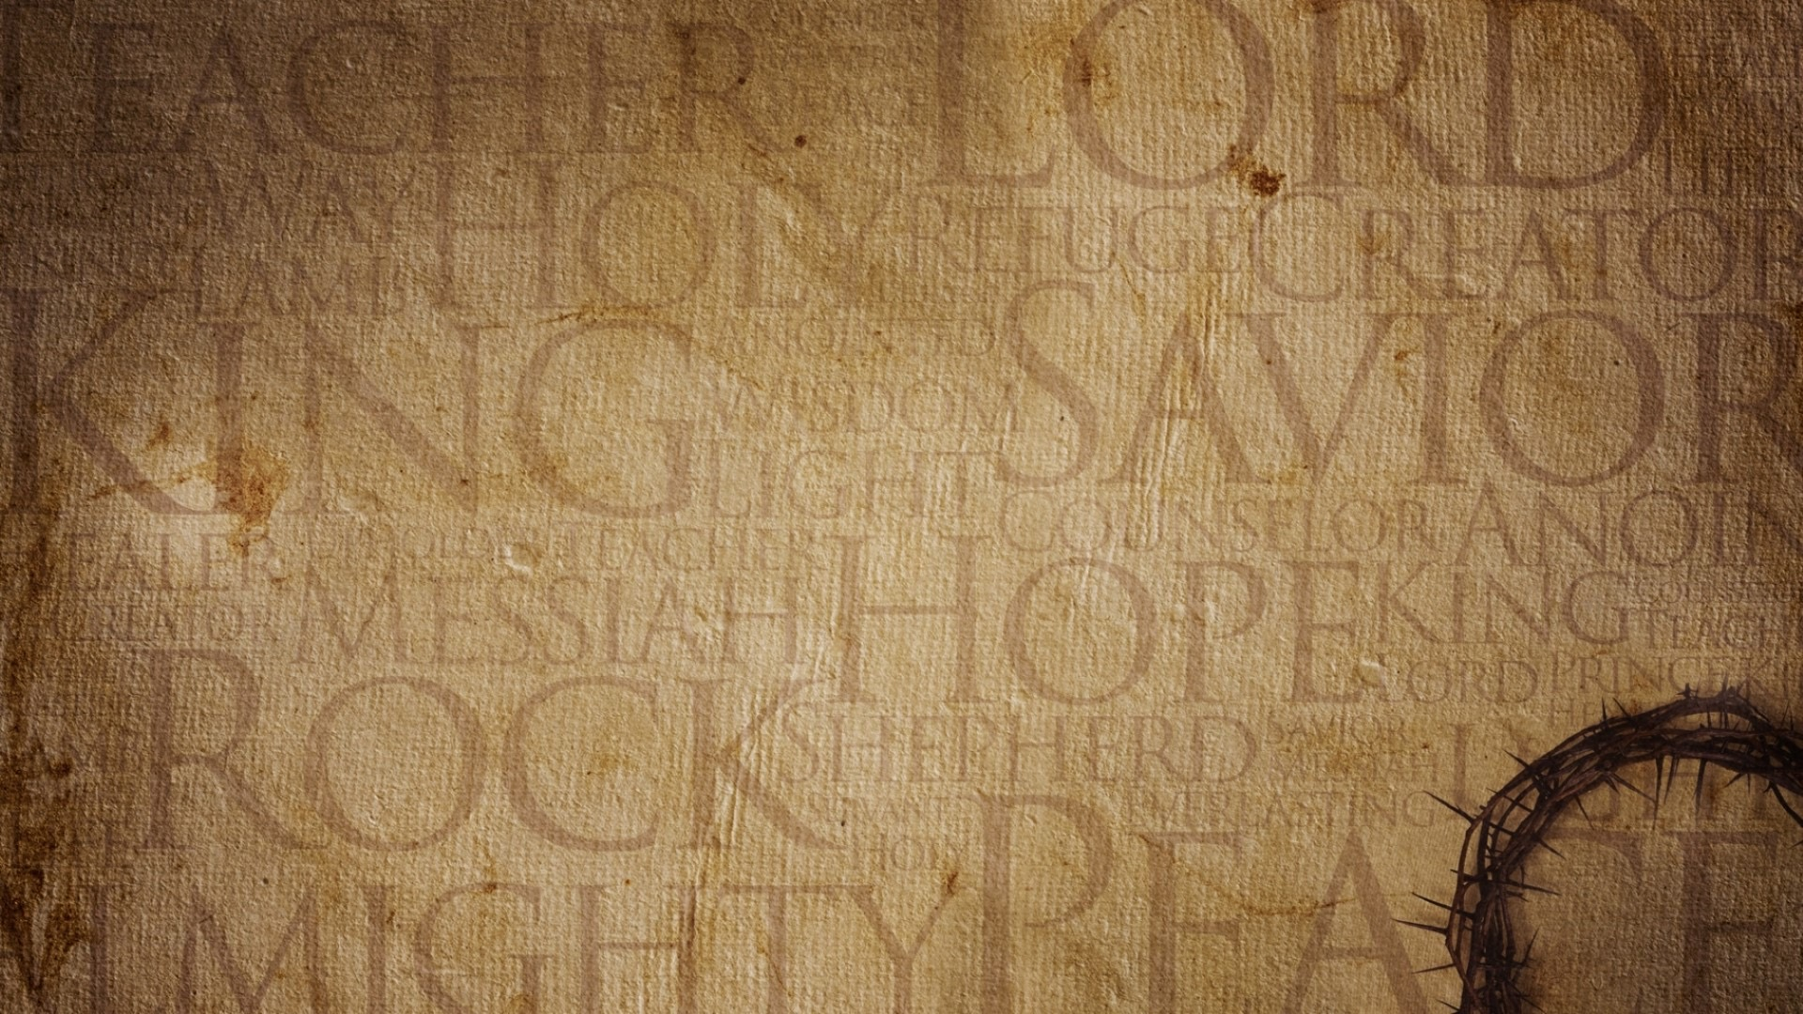
O Lord, our Lord, how majestic is your name in all the earth! You have set your glory above the heavens. Out of the mouth of babies and infants, you have established strength because of your foes, to still the enemy and the avenger.
Psalm 8:1–2
ESV

Slide 3
When I observe Your heavens, the work of Your fingers, the moon and the stars, which You set in place, what is man that You remember him, the son of man that You look after him?
Psalm 8:3–4
HCSB

Slide 4
Yet You have made him a little lower than God, And You crown him with glory and majesty! You make him to rule over the works of Your hands; You have put all things under his feet,
Psalm 8:5–6
NASB95

Slide 5
all the sheep and oxen, as well as the animals in the wild, the birds of the sky, and the fish of the sea that pass through the currents of the seas.
Psalm 8:7–8
HCSB

Slide 6
Then God said, “Let us make man in our image, after our likeness. And let them have dominion over the fish of the sea and over the birds of the heavens and over the livestock and over all the earth and over every creeping thing that creeps on the earth.”
Genesis 1:26
ESV

Slide 7
So God created man in his own image, in the image of God he created him; male and female he created them.
Genesis 1:27
ESV

Slide 8
And God blessed them. And God said to them, “Be fruitful and multiply and fill the earth and subdue it, and have dominion over the fish of the sea and over the birds of the heavens and over every living thing that moves on the earth.”
Genesis 1:28
ESV

Slide 9
And the devil took him up and showed him all the kingdoms of the world in a moment of time,
Luke 4:5
ESV

Slide 10
and said to him, “To you I will give all this authority and their glory, for it has been delivered to me, and I give it to whom I will.
Luke 4:6
ESV

Slide 11
If you, then, will worship me, it will all be yours.”
Luke 4:7
ESV

Slide 12
You said in your heart, ‘I will ascend to heaven; above the stars of God I will set my throne on high; I will sit on the mount of assembly in the far reaches of the north; I will ascend above the heights of the clouds; I will make myself like the Most High.’
Isaiah 14:13–14
ESV

Slide 13
Now war arose in heaven, Michael and his angels fighting against the dragon. And the dragon and his angels fought back, but he was defeated, and there was no longer any place for them in heaven.
Revelation 12:7–8
ESV

Slide 14
And the great dragon was thrown down, that ancient serpent, who is called the devil and Satan, the deceiver of the whole world—he was thrown down to the earth, and his angels were thrown down with him.
Revelation 12:9
ESV

Slide 15
What are Angels?

Slide 16
Angels are God’s ministering spirit’s sent by God to care for His masterpieces: men and women.

Slide 17
And to which of the angels has he ever said, “Sit at my right hand until I make your enemies a footstool for your feet”?
Hebrews 1:13
ESV

Slide 18
Are they not all ministering spirits sent out to serve for the sake of those who are to inherit salvation?
Hebrews 1:14
ESV

Slide 19
Demons mission is to keep men and women thinking and believing that we are less than what we are: God’s masterpiece - His Image-Bearers.

Slide 20
The Good News of Redemption

Slide 21
Have this mind among yourselves, which is yours in Christ Jesus, who, though he was in the form of God, did not count equality with God a thing to be grasped,
Philippians 2:5–6
ESV

Slide 22
but emptied himself, by taking the form of a servant, being born in the likeness of men.
Philippians 2:7
ESV

Slide 23
You made him for a little while lower than the angels; you have crowned him with glory and honor,
Hebrews 2:7
ESV

Slide 24
putting everything in subjection under his feet.” Now in putting everything in subjection to him, he left nothing outside his control. At present, we do not yet see everything in subjection to him.
Hebrews 2:8
ESV

Slide 25
But we see him who for a little while was made lower than the angels, namely Jesus, crowned with glory and honor because of the suffering of death, so that by the grace of God he might taste death for everyone.
Hebrews 2:9
ESV

Slide 26
For it was fitting that he, for whom and by whom all things exist, in bringing many sons to glory, should make the founder of their salvation perfect through suffering.
Hebrews 2:10
ESV

Slide 27
And now, Father, glorify me in your own presence with the glory that I had with you before the world existed.
John 17:5
ESV

Slide 28
Men and women were created and delegated with God’s power and authority to live and rule over God’s creation (Genesis 1:26-28).

Slide 29
The disciple of Christ’s job is to walk in and exercise the restored power and delegated authority, that Jesus took back at the cross.

Slide 30
Do You Have Jesus’ Credit Card?

Slide 31
“I can do nothing on my own. As I hear, I judge, and my judgment is just, because I seek not my own will but the will of him who sent me.
John 5:30
ESV

Slide 32
So Jesus said to them, “Truly, truly, I say to you, the Son can do nothing of his own accord, but only what he sees the Father doing. For whatever the Father does, that the Son does likewise.
John 5:19
ESV

Slide 33
So Jesus said to them, “When you have lifted up the Son of Man, then you will know that I am he, and that I do nothing on my own authority, but speak just as the Father taught me.
John 8:28
ESV

Slide 34
What was Jesus’ source of authority? His intimacy with the Father in prayer, doing His will, following the prompting of the Holy Spirit. His duty? To fulfill the work and will of the Father, by the power and authority of the Holy Spirit.

Slide 35
Do you realize that you have been given the same credit card that Jesus wielded while on earth?

Slide 36
And Jesus came and said to them, “All authority in heaven and on earth has been given to me.
Matthew 28:18
ESV

Slide 37
Go therefore and make disciples of all nations, baptizing them in the name of the Father and of the Son and of the Holy Spirit,
Matthew 28:19
ESV

Slide 38
teaching them to observe all that I have commanded you. And behold, I am with you always, to the end of the age.”
Matthew 28:20
ESV

Slide 39
“Truly, truly, I say to you, whoever believes in me will also do the works that I do; and greater works than these will he do, because I am going to the Father.
John 14:12
ESV

Slide 40
What Does this Mean for You and Me?

Slide 41
1. You were intended to be second to God Himself (Ps 8:5; Genesis 1:26)

Slide 42
2. You are redeemed (1 Cor. 15:45-47)

Slide 43
3. Children of God (1 Jn 3:1)

Slide 44
See what kind of love the Father has given to us, that we should be called children of God; and so we are. The reason why the world does not know us is that it did not know him.
1 John 3:1
ESV

Slide 45
4. We have the Holy Spirit (Acts 2)

Slide 46
5. Been entrusted with divine authority

Slide 47
6. Inseparable from our spiritual authority

