Slide 1

The Attitude of Mercy
Matthew 5:7; 18:21-35; Genesis 37-48

Slide 2
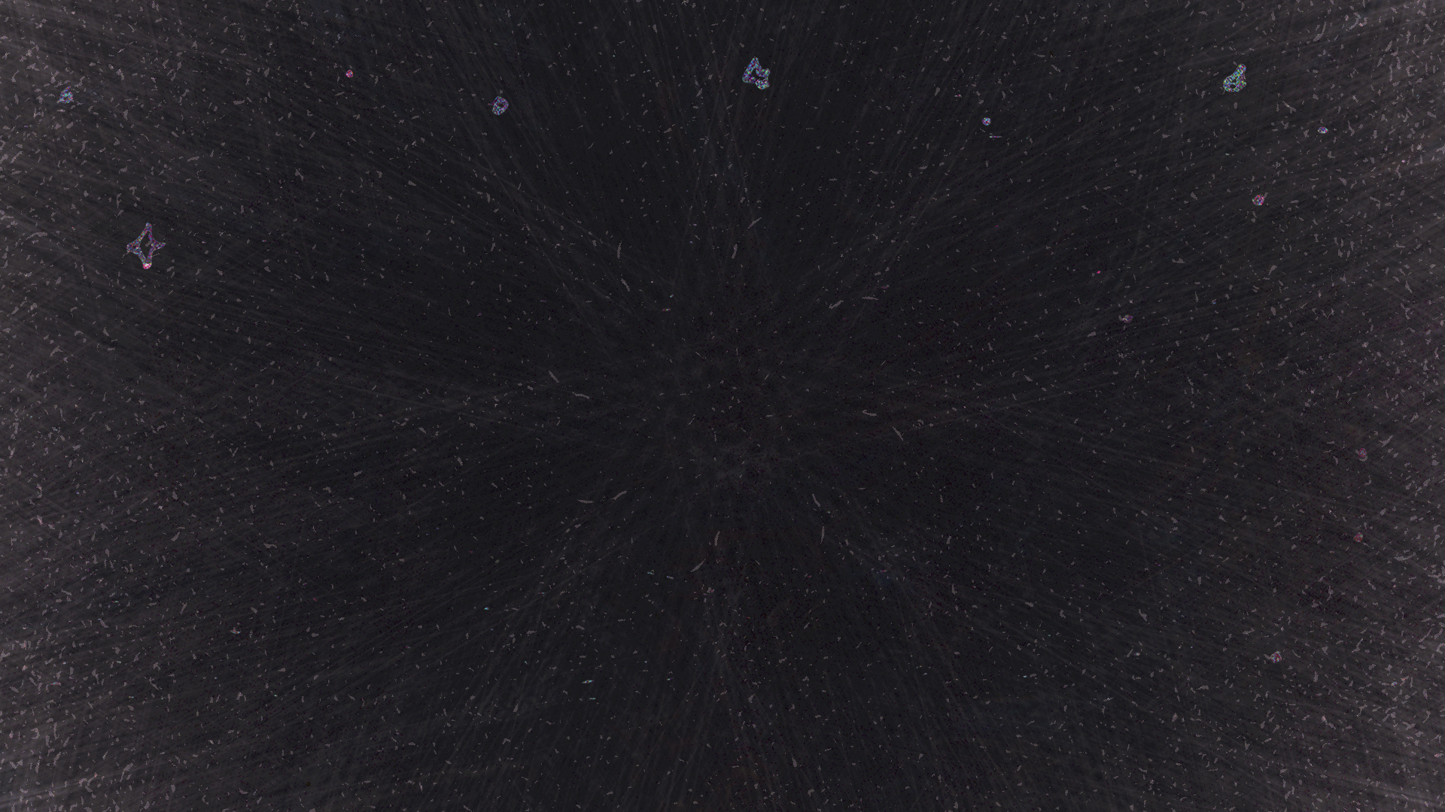
God blesses those who are merciful, for they will be shown mercy.
Matthew 5:7
NLT

Slide 3
You must be compassionate, just as your Father is compassionate.
Luke 6:36
NLT

Slide 4
The Lord is merciful and gracious, slow to anger and abounding in steadfast love.
Psalm 103:8
ESV

Slide 5
And whenever you stand praying, forgive, if you have anything against anyone, so that your Father also who is in heaven may forgive you your trespasses.”
Mark 11:25
ESV

Slide 6
And the King will answer them, ‘Truly, I say to you, as you did it to one of the least of these my brothers, you did it to me.’
Matthew 25:40
ESV

Slide 7
Then he will answer them, saying, ‘Truly, I say to you, as you did not do it to one of the least of these, you did not do it to me.’
Matthew 25:45
ESV

Slide 8
And these will go away into eternal punishment, but the righteous into eternal life.”
Matthew 25:46
ESV

Slide 9
What the Parable of the Unmerciful Servant does not say

Slide 10
1. Forgiveness or unforgiveness does not affect one’s salvation.

Slide 11
For by grace you have been saved through faith. And this is not your own doing; it is the gift of God, not a result of works, so that no one may boast.
Ephesians 2:8–9
ESV

Slide 12
But if it is by grace, it is no longer on the basis of works; otherwise grace would no longer be grace.
Romans 11:6
ESV

Slide 13
And since it is through God’s kindness, then it is not by their good works. For in that case, God’s grace would not be what it really is—free and undeserved.
Romans 11:6
NLT

Slide 14
What the Parable of the Unmerciful Servant does say to us

Slide 15
1. We are forgiven an incalculable debt. Just how indebted are we/were we? So much so that we deserve death and eternal punishment. And how indebted? That it took perfect God, Jesus to satisfy it by his death and sacrifice (Col 1:13-14; Heb 9:12; 1 Tim 2:5-6).

Slide 16
He has delivered us from the domain of darkness and transferred us to the kingdom of his beloved Son, in whom we have redemption, the forgiveness of sins.
Colossians 1:13–14
ESV

Slide 17
For there is one God, and there is one mediator between God and men, the man Christ Jesus, who gave himself as a ransom for all, which is the testimony given at the proper time.
1 Timothy 2:5–6
ESV

Slide 18
2. We are to be merciful to others as God is rich in mercy to us (Lk 6:36).

Slide 19
3. God hates ingratitude (Lk 22:19)

Slide 20
Make allowance for each other’s faults, and forgive anyone who offends you. Remember, the Lord forgave you, so you must forgive others.
Colossians 3:13
NLT

Slide 21
4. God holds us personally to account (Mt 7:1-2).

Slide 22
So also my heavenly Father will do to every one of you, if you do not forgive your brother from your heart.”
Matthew 18:35
ESV

Slide 23
5. We are to repeatedly forgive.

Slide 24
The attitude of mercy is the action of grace in forgiveness.

Slide 25
bless those who curse you, pray for those who abuse you.
Luke 6:28
ESV

Slide 26
“If you love those who love you, what benefit is that to you? For even sinners love those who love them.
Luke 6:32
ESV

Slide 27
But love your enemies, and do good, and lend, expecting nothing in return, and your reward will be great, and you will be sons of the Most High, for he is kind to the ungrateful and the evil.
Luke 6:35
ESV

Slide 28
Get rid of all bitterness, rage, anger, harsh words, and slander, as well as all types of evil behavior.
Ephesians 4:31
NLT

Slide 29
And do not bring sorrow to God’s Holy Spirit by the way you live. Remember, he has identified you as his own, guaranteeing that you will be saved on the day of redemption.
Ephesians 4:30
NLT

Slide 30
Instead, be kind to each other, tenderhearted, forgiving one another, just as God through Christ has forgiven you.
Ephesians 4:32
NLT

Slide 31
There is much more we would like to say about this, but it is difficult to explain, especially since you are spiritually dull and don’t seem to listen.
Hebrews 5:11
NLT

Slide 32
You have been believers so long now that you ought to be teaching others. Instead, you need someone to teach you again the basic things about God’s word. You are like babies who need milk and cannot eat solid food.
Hebrews 5:12
NLT

Slide 33
For God is not unjust. He will not forget how hard you have worked for him and how you have shown your love to him by caring for other believers, as you still do.
Hebrews 6:10
NLT

Slide 34
Our great desire is that you will keep on loving others as long as life lasts, in order to make certain that what you hope for will come true.
Hebrews 6:11
NLT

Slide 35
Then you will not become spiritually dull and indifferent. Instead, you will follow the example of those who are going to inherit God’s promises because of their faith and endurance.
Hebrews 6:12
NLT

