Slide 1

Whenever …What is it Really About?
Matthew 6:1-18

Slide 2
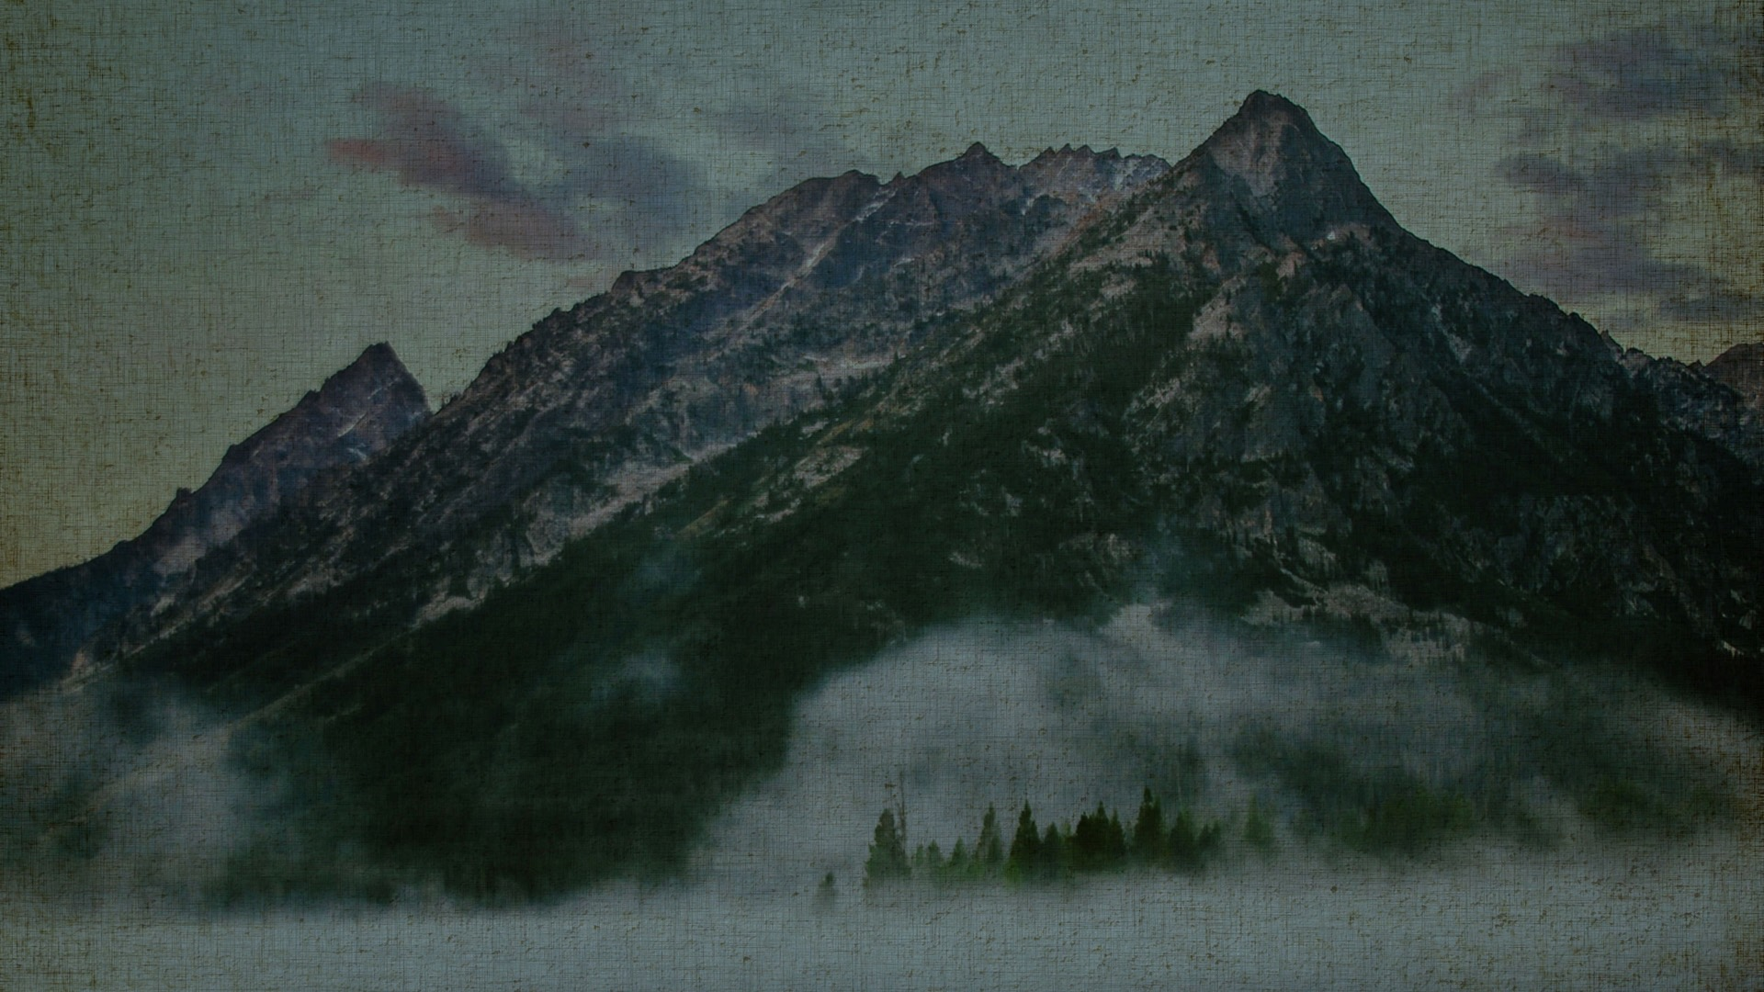
“Beware of practicing your righteousness before other people in order to be seen by them, for then you will have no reward from your Father who is in heaven.
Matthew 6:1
ESV

Slide 3
“Thus, when you give to the needy, sound no trumpet before you, as the hypocrites do in the synagogues and in the streets, that they may be praised by others. Truly, I say to you, they have received their reward.
Matthew 6:2
ESV

Slide 4
But when you give to the needy, do not let your left hand know what your right hand is doing, so that your giving may be in secret. And your Father who sees in secret will reward you.
Matthew 6:3–4
ESV

Slide 5
“And when you pray, you must not be like the hypocrites. For they love to stand and pray in the synagogues and at the street corners, that they may be seen by others. Truly, I say to you, they have received their reward.
Matthew 6:5
ESV

Slide 6
But when you pray, go into your room and shut the door and pray to your Father who is in secret. And your Father who sees in secret will reward you.
Matthew 6:6
ESV

Slide 7
“And when you pray, do not heap up empty phrases as the Gentiles do, for they think that they will be heard for their many words. Do not be like them, for your Father knows what you need before you ask him.
Matthew 6:7–8
ESV

Slide 8
Pray then like this: “Our Father in heaven, hallowed be your name. Your kingdom come, your will be done, on earth as it is in heaven.
Matthew 6:9–10
ESV

Slide 9
Give us this day our daily bread, and forgive us our debts, as we also have forgiven our debtors.
Matthew 6:11–12
ESV

Slide 10
And lead us not into temptation, but deliver us from evil. For if you forgive others their trespasses, your heavenly Father will also forgive you, but if you do not forgive others their trespasses, neither will your Father forgive your trespasses.
Matthew 6:13–15
ESV

Slide 11
“And when you fast, do not look gloomy like the hypocrites, for they disfigure their faces that their fasting may be seen by others. Truly, I say to you, they have received their reward. But when you fast, anoint your head and wash your face,
Matthew 6:16–17
ESV

Slide 12
that your fasting may not be seen by others but by your Father who is in secret. And your Father who sees in secret will reward you.
Matthew 6:18
ESV

Slide 13
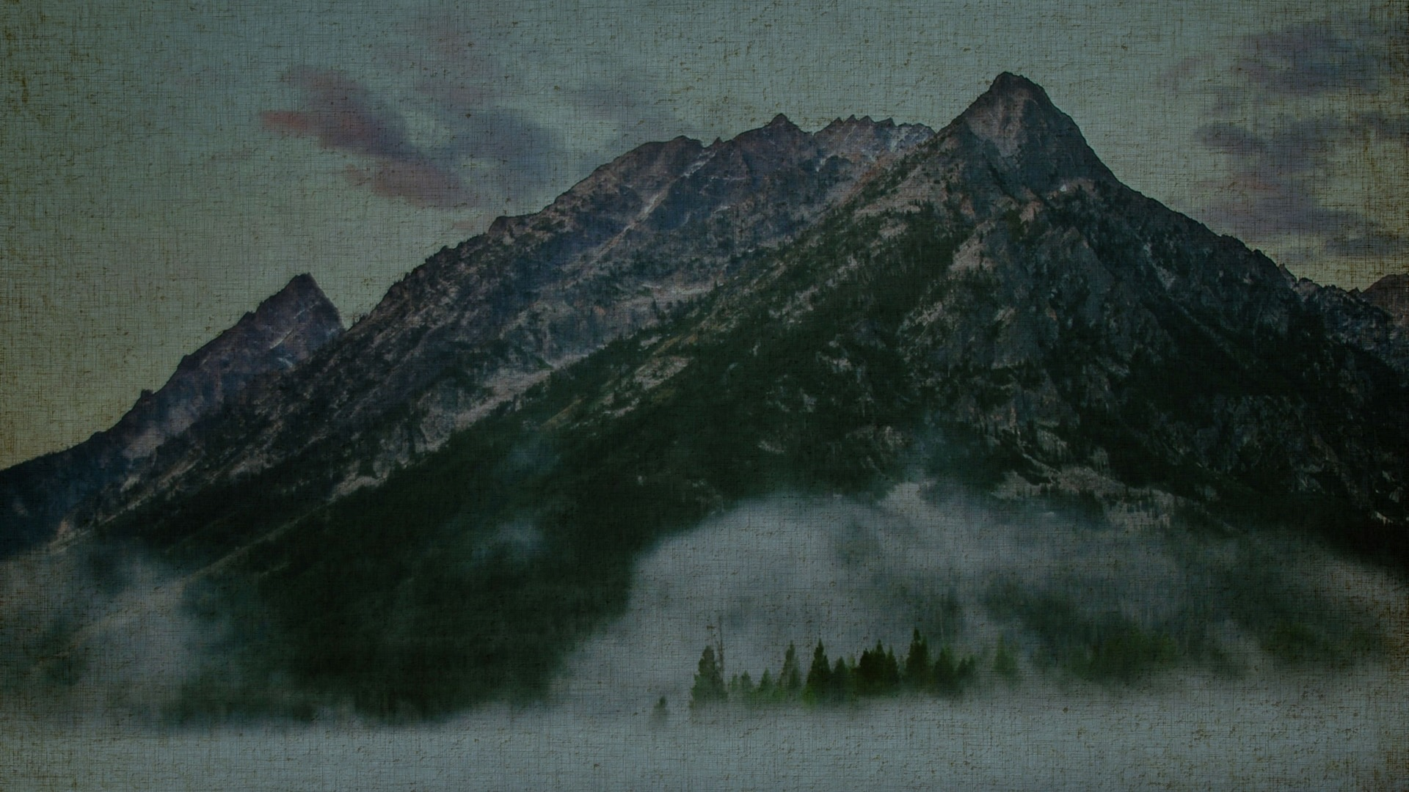
What is a pitfall? Merriam-Webster defines a pitfall as a hidden danger or difficulty that is not easily recognized.

Slide 14
When the Spirit of truth comes, he will guide you into all the truth, for he will not speak on his own authority, but whatever he hears he will speak, and he will declare to you the things that are to come. He will glorify me, for he will take what is mine and declare it to you. All that the Father has is mine; therefore I said that he will take what is mine and declare it to you.
John 16:13–15
ESV

Slide 15
Jesus said to them, “My food is to do the will of him who sent me and to accomplish his work.
John 4:34
ESV

Slide 16
For whoever does the will of my Father in heaven is my brother and sister and mother.”
Matthew 12:50
ESV

Slide 17
Whatever you do, whenever you do it, make sure to bring glory to God in all of it.

Slide 18
“Woe to you, scribes and Pharisees, hypocrites! For you are like whitewashed tombs, which outwardly appear beautiful, but within are full of dead people’s bones and all uncleanness. So you also outwardly appear righteous to others, but within you are full of hypocrisy and lawlessness.
Matthew 23:27–28
ESV

Slide 19
You hypocrites! Well did Isaiah prophesy of you, when he said: “ ‘This people honors me with their lips, but their heart is far from me; in vain do they worship me, teaching as doctrines the commandments of men.’ ”
Matthew 15:7–9
ESV

Slide 20
“Thus, when you give to the needy, sound no trumpet before you, as the hypocrites do in the synagogues and in the streets, that they may be praised by others. Truly, I say to you, they have received their reward. But when you give to the needy, do not let your left hand know what your right hand is doing,
Matthew 6:2–3
ESV

Slide 21
But when you pray, go into your room and shut the door and pray to your Father who is in secret. And your Father who sees in secret will reward you. “And when you pray, do not heap up empty phrases as the Gentiles do, for they think that they will be heard for their many words.
Matthew 6:6–7
ESV

Slide 22
“And when you fast, do not look gloomy like the hypocrites, for they disfigure their faces that their fasting may be seen by others. Truly, I say to you, they have received their reward. But when you fast, anoint your head and wash your face, that your fasting may not be seen by others but by your Father who is in secret. And your Father who sees in secret will reward you.
Matthew 6:16–18
ESV

