Slide 1

A Thanksgiving Sacrifice
Leviticus 7:11-15

Slide 2

As the days of Noah were, so the coming of the Son of Man will be. For in those days before the flood they were eating and drinking, marrying and giving in marriage, until the day Noah boarded the ark.
Matthew 24:37–38
HCSB

Slide 3
When the Lord saw that man’s wickedness was widespread on the earth and that every scheme his mind thought of was nothing but evil all the time,
Genesis 6:5
HCSB

Slide 4
the Lord regretted that He had made man on the earth, and He was grieved in His heart.
Genesis 6:6
HCSB

Slide 5
Then the Lord said, “I will wipe off from the face of the earth mankind, whom I created, together with the animals, creatures that crawl, and birds of the sky—for I regret that I made them.”
Genesis 6:7
HCSB

Slide 6
Then I saw heaven opened, and there was a white horse. Its rider is called Faithful and True, and He judges and makes war in righteousness.
Revelation 19:11
HCSB

Slide 7
His eyes were like a fiery flame, and many crowns were on His head. He had a name written that no one knows except Himself.
Revelation 19:12
HCSB

Slide 8
He wore a robe stained with blood, and His name is the Word of God.
Revelation 19:13
HCSB

Slide 9
The armies that were in heaven followed Him on white horses, wearing pure white linen.
Revelation 19:14
HCSB

Slide 10
A sharp sword came from His mouth, so that He might strike the nations with it. He will shepherd them with an iron scepter. He will also trample the winepress of the fierce anger of God, the Almighty.
Revelation 19:15
HCSB

Slide 11
And He has a name written on His robe and on His thigh: KING OF KINGS
AND LORD OF LORDS.
Revelation 19:16
HCSB

Slide 12
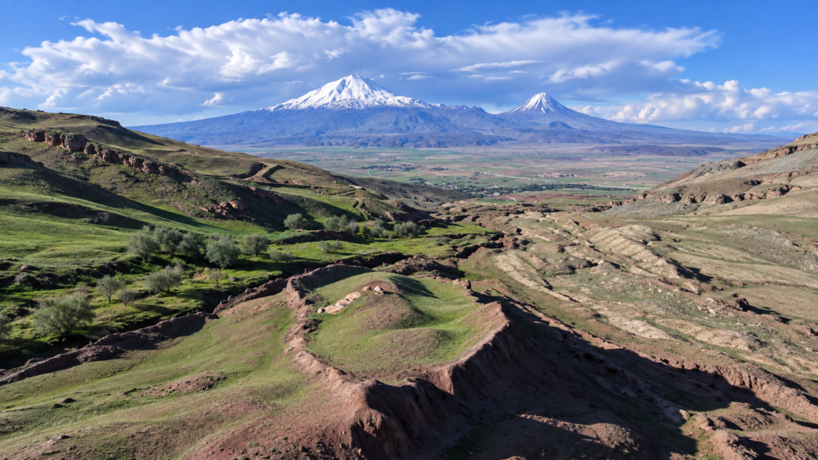
Durupinar formation site on Mount Ararat in Turkey

Slide 13
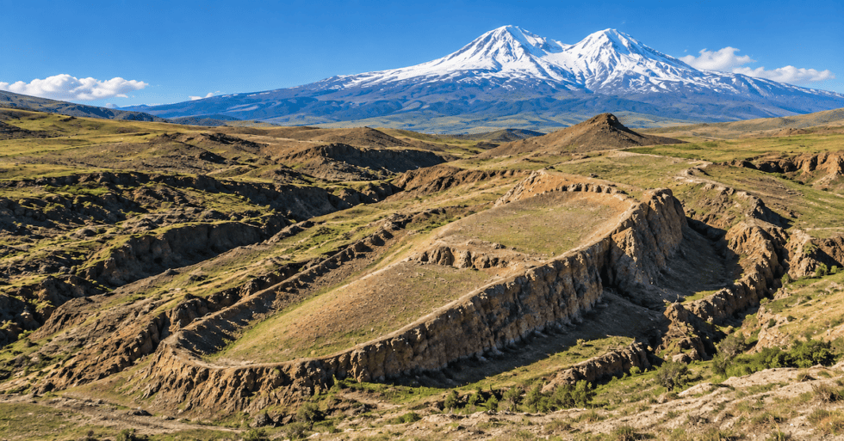
Durupinar formation site on Mount Ararat in Turkey

Slide 14
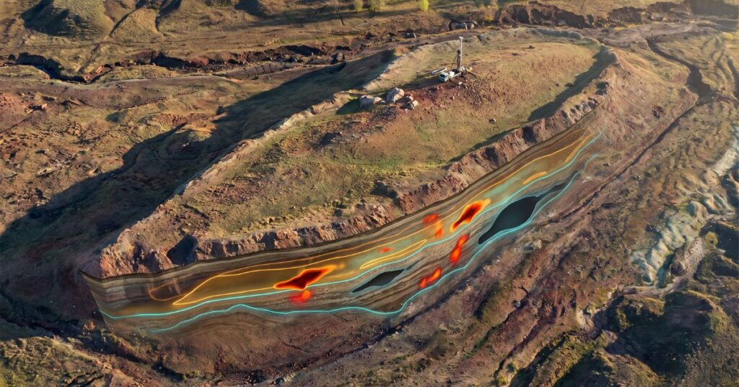
full ground-penetrating radar (GPR) scan

Slide 15
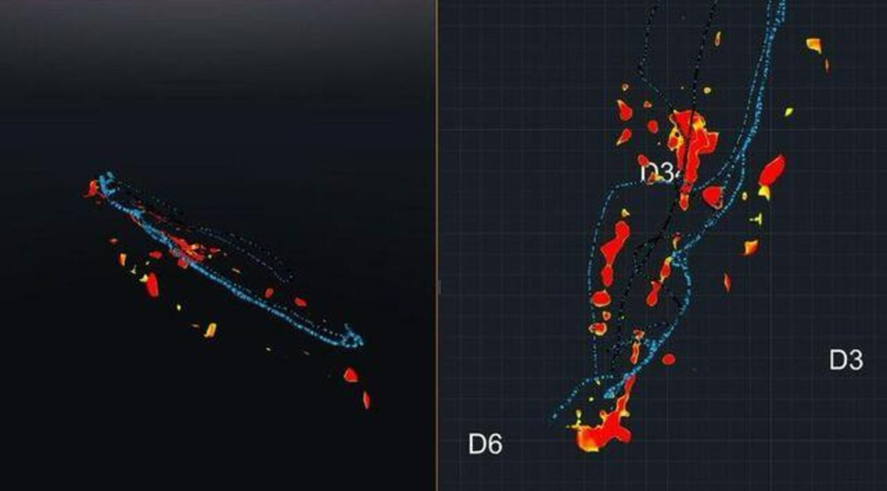
full ground-penetrating radar (GPR) scan

Slide 16
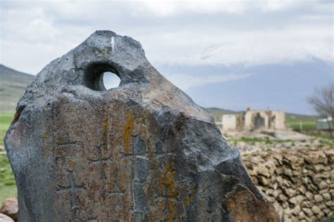
drogue stone

Slide 17
But know this: Difficult times will come in the last days.
2 Timothy 3:1
HCSB

Slide 18
For people will be lovers of self, lovers of money, boastful, proud, blasphemers, disobedient to parents, ungrateful, unholy,
2 Timothy 3:2
HCSB

Slide 19
unloving, irreconcilable, slanderers, without self-control, brutal, without love for what is good,
2 Timothy 3:3
HCSB

Slide 20
traitors, reckless, conceited, lovers of pleasure rather than lovers of God,
2 Timothy 3:4
HCSB

Slide 21
holding to the form of godliness but denying its power. Avoid these people!
2 Timothy 3:5
HCSB

Slide 22
Acharistos (884) unthankful; without kindness or favor.

Slide 23
If we believe in Jesus, we belong to Jesus, then we will chose to be a blessing of Jesus, not a beast of men.

Slide 24
“Now this is the law of the fellowship sacrifice that someone may present to the Lord:
Leviticus 7:11
HCSB

Slide 25
If he presents it for thanksgiving, in addition to the thanksgiving sacrifice, he is to present unleavened cakes mixed with olive oil, unleavened wafers coated with oil, and well-kneaded cakes of fine flour mixed with oil.
Leviticus 7:12
HCSB

Slide 26
The sacrifice of Thanksgiving has to do with maintaining peace with God.

Slide 27
When we offer up our prayer of thanksgiving unto the Lord, we are recognizing His power and control over us, as well as His love for us.

Slide 28
Every generous act and every perfect gift is from above, coming down from the Father of lights; with Him there is no variation or shadow cast by turning.
James 1:17
HCSB

Slide 29
Why is thanksgiving a part of a peace offering?

Slide 30
Thanksgiving can only be truly a day of thanks if we believe that Jesus made a way of peace for us.

Slide 31
Our sacrifices of Thanksgiving must be offered only through Christ ....who is represented by the unleavened bread.

Slide 32
Can one be truly thankful until we’ve been through fire, through the heat of trials and tests?

Slide 33
He is to present as his offering cakes of leavened bread with his thanksgiving sacrifice of fellowship.
Leviticus 7:13
HCSB

Slide 34
In the offering of the unleavened bread we are recognizing the fact that we must offer ourselves as living sacrifices, holy and acceptable to God.

Slide 35
We are also required to offer ourselves as sacrifices in service if we are to have peace with God.

Slide 36
From the cakes he must present one portion of each offering as a contribution to the Lord. It will belong to the priest who sprinkles the blood of the fellowship offering; it is his.
Leviticus 7:14
HCSB

Slide 37
We must learn to place our trust in Jesus, to hold back nothing.

Slide 38
The meat of his thanksgiving sacrifice of fellowship must be eaten on the day he offers it; he may not leave any of it until morning.
Leviticus 7:15
HCSB

Slide 39
The sacrifice of the flesh... a symbol of the fact that when we have offered a true sacrifice of thanksgiving, then everyone is blessed by it at the same time.

Slide 40
Sacrifice to be totally consumed - a reminder to us that every day is a new day, and that every new day brings with it a fresh requirement for us to have a heart of thanksgiving unto the Lord.

Slide 41
Don’t worry about anything, but in everything, through prayer and petition with thanksgiving, let your requests be made known to God.
Philippians 4:6
HCSB

Slide 42
And the peace of God, which surpasses every thought, will guard your hearts and minds in Christ Jesus.
Philippians 4:7
HCSB

Slide 43
All the angels stood around the throne, the elders, and the four living creatures, and they fell facedown before the throne and worshiped God,
Revelation 7:11
HCSB

Slide 44
saying: Amen! Blessing and glory and wisdom and thanksgiving and honor and power and strength be to our God forever and ever. Amen.
Revelation 7:12
HCSB

