Slide 1
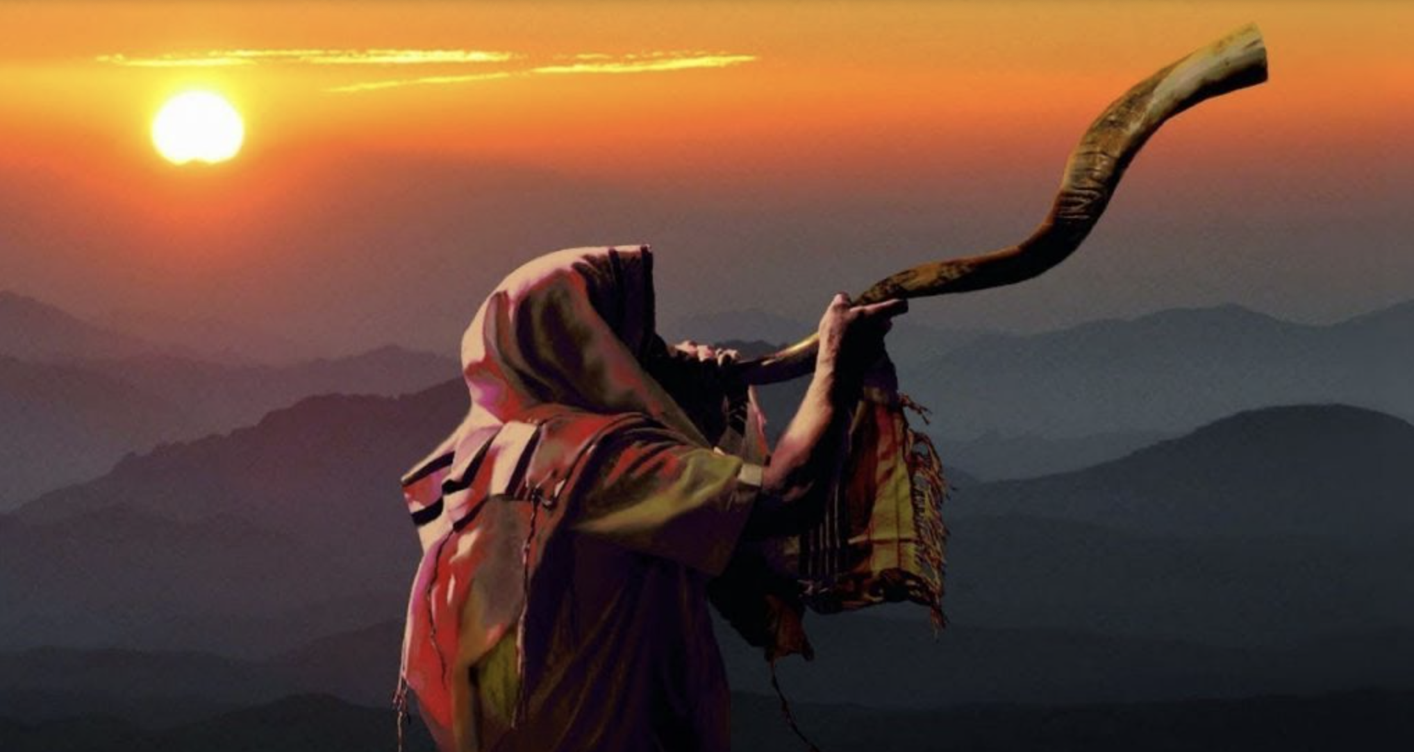
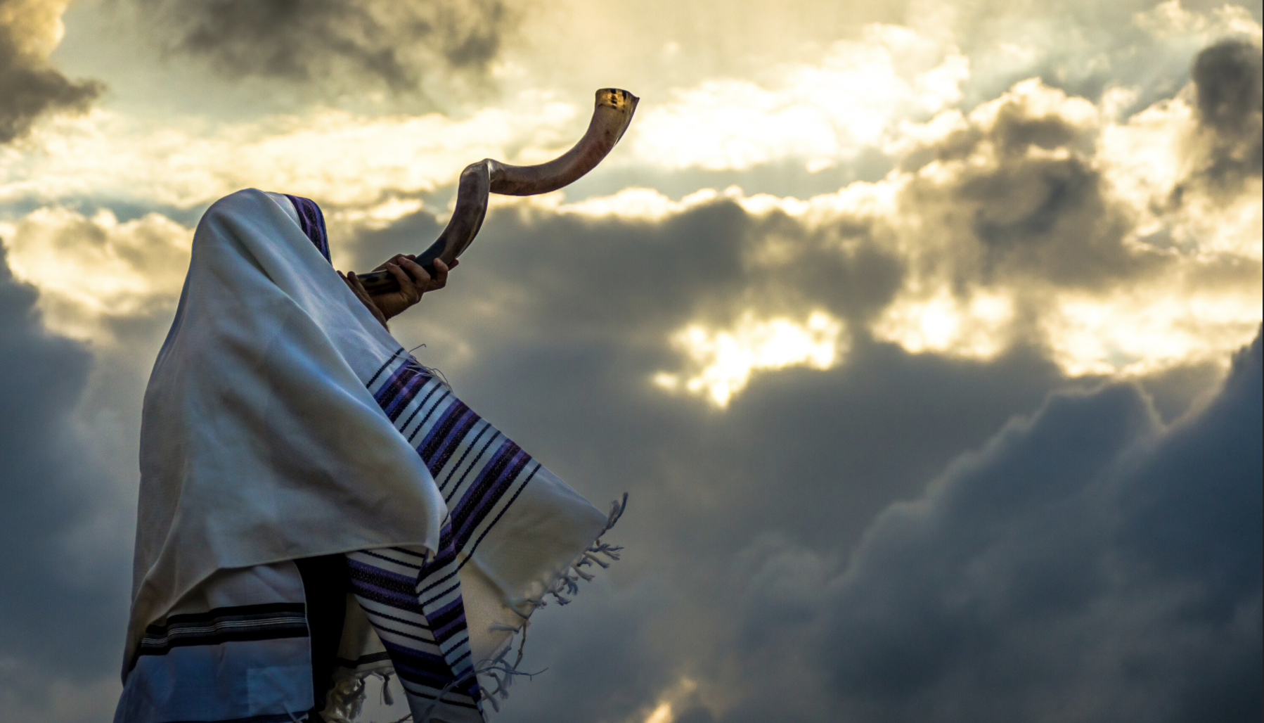
The Feast of Atonement
The Feast of Atonement
Transformed in Christ

Slide 2

The Lord again spoke to Moses: “The tenth day of this seventh month is the Day of Atonement. You are to hold a sacred assembly and practice self-denial; you are to present a fire offering to the Lord.
Leviticus 23:26-27

Slide 3
On this particular day you are not to do any work, for it is a Day of Atonement to make atonement for yourselves before the Lord your God. If any person does not practice self-denial on this particular day, he must be cut off from his people.
Leviticus 23:28-29

Slide 4
I will destroy among his people anyone who does any work on this same day. You are not to do any work. This is a permanent statute throughout your generations wherever you live.
Leviticus 23:30-31

Slide 5
It will be a Sabbath of complete rest for you, and you must practice self-denial. You are to observe your Sabbath from the evening of the ninth day of the month until the following evening.”
Leviticus 23:32

Slide 6
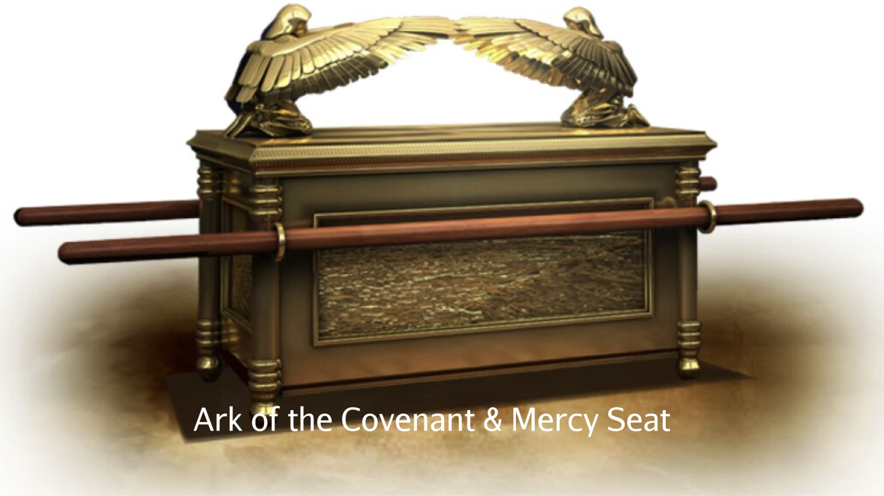

Slide 7
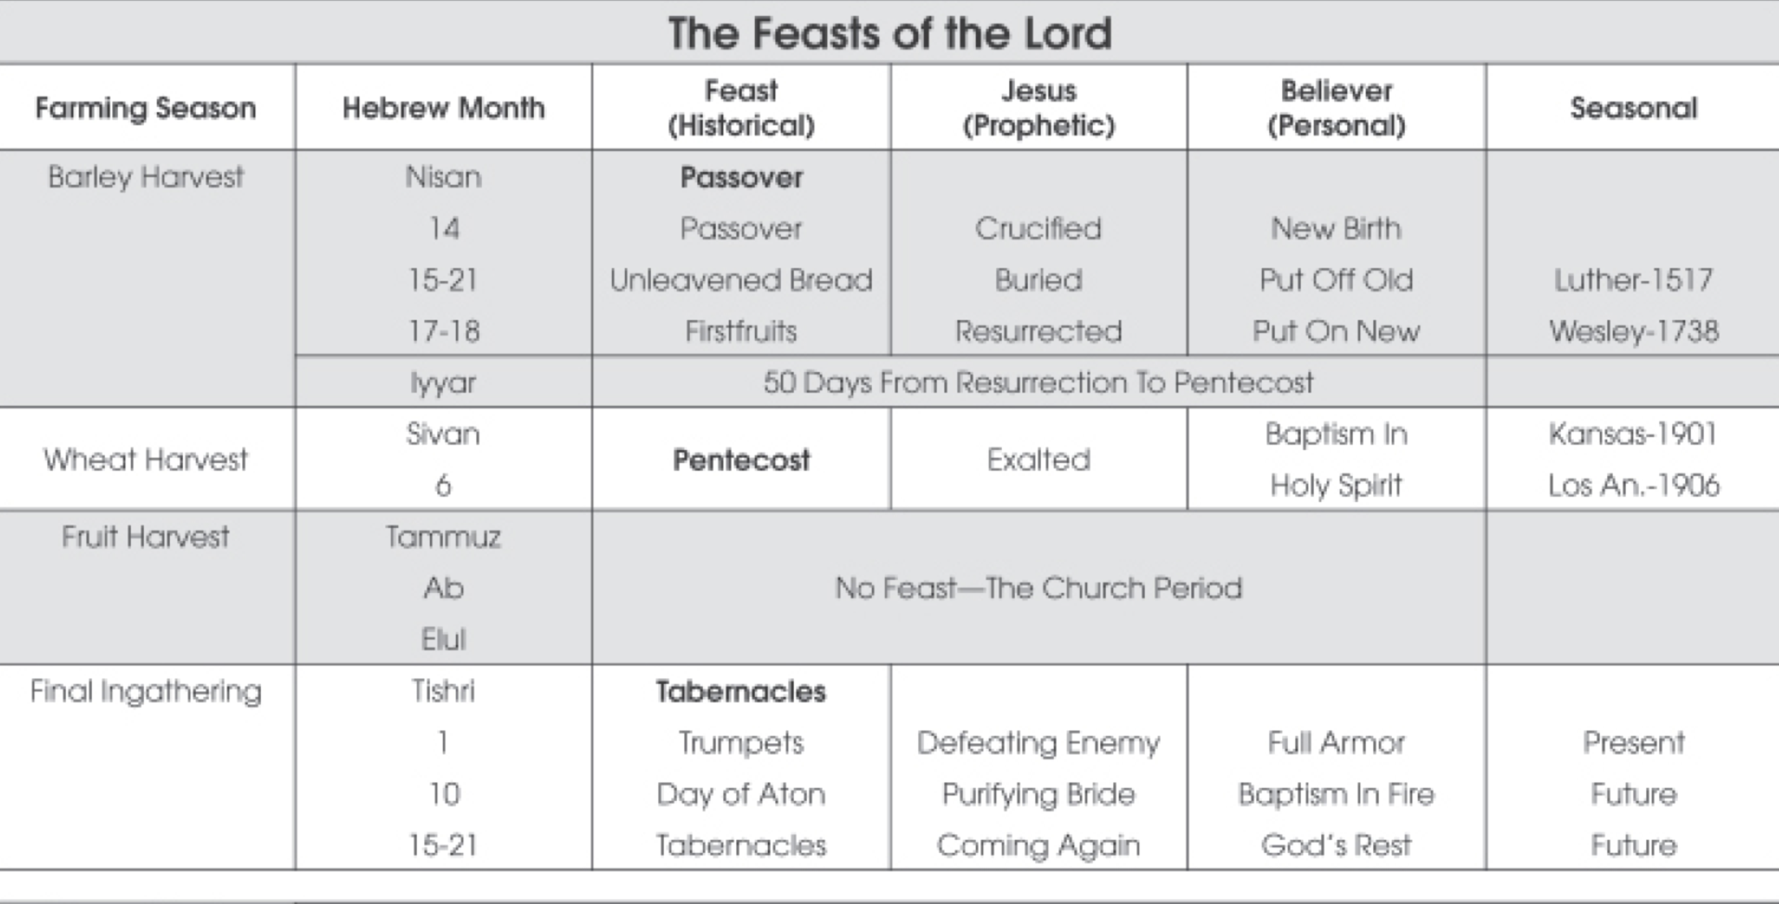

Slide 8
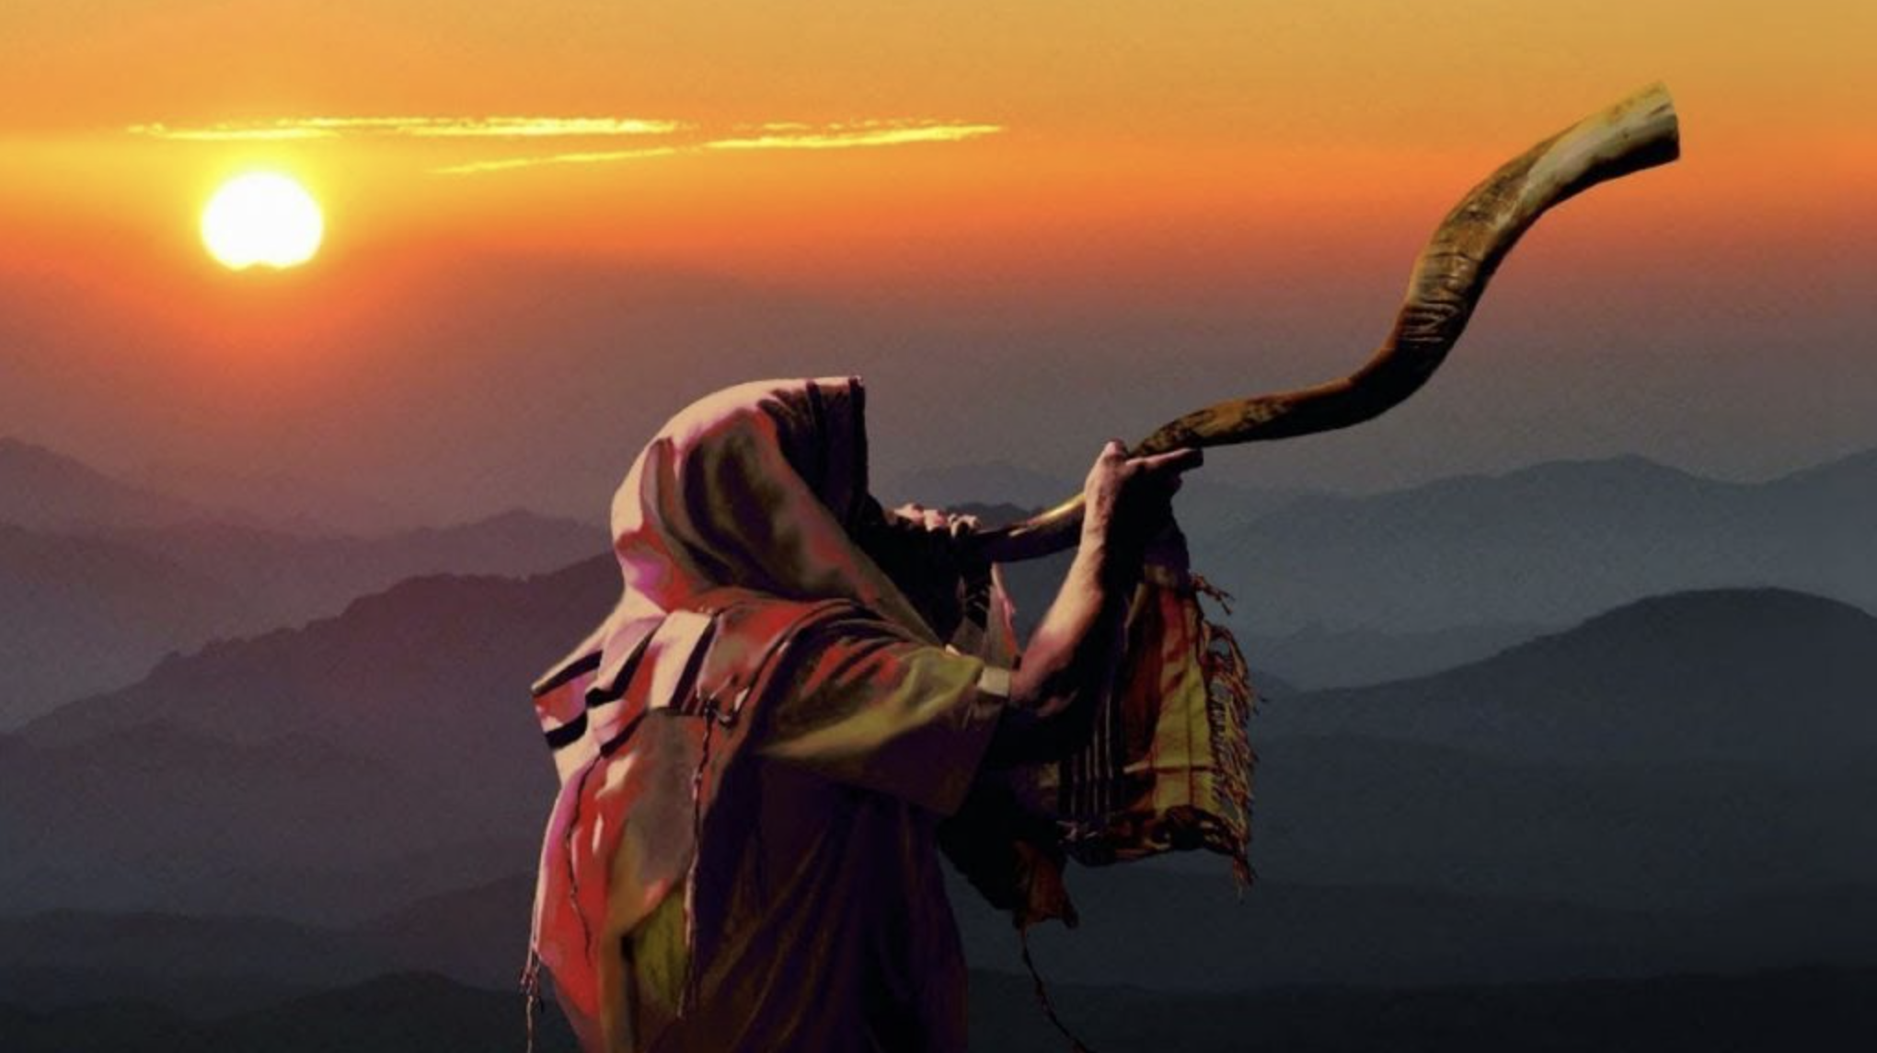
Jesus’ Prophetic Fulfillment
Jesus’ Prophetic Fulfillment

Slide 9
If we say, “We have fellowship with Him,” yet we walk in darkness, we are lying and are not practicing the truth. But if we walk in the light as He Himself is in the light, we have fellowship with one another, and the blood of Jesus His Son cleanses us from all sin.
1 John 1:6–7
HCSB

Slide 10
If we say, “We have no sin,” we are deceiving ourselves, and the truth is not in us. If we confess our sins, He is faithful and righteous to forgive us our sins and to cleanse us from all unrighteousness.
1 John 1:8–9
HCSB

Slide 11
He entered the most holy place once for all, not by the blood of goats and calves, but by His own blood, having obtained eternal redemption. For if the blood of goats and bulls and the ashes of a young cow, sprinkling those who are defiled, sanctify for the purification of the flesh,
Hebrews 9:12–13
HCSB

Slide 12
how much more will the blood of the Messiah, who through the eternal Spirit offered Himself without blemish to God, cleanse our consciences from dead works to serve the living God?
Hebrews 9:14
HCSB

Slide 13
Jesus told him, “I am the way, the truth, and the life. No one comes to the Father except through Me.
John 14:6
HCSB

Slide 14
In the same way, the victor will be dressed in white clothes, and I will never erase his name from the book of life but will acknowledge his name before My Father and before His angels.
Revelation 3:5
HCSB

Slide 15
Nothing profane will ever enter it: no one who does what is vile or false, but only those written in the Lamb’s book of life.
Revelation 21:27
HCSB

Slide 16
If we confess our sins, He is faithful and righteous to forgive us our sins and to cleanse us from all unrighteousness.
1 John 1:9
HCSB

Slide 17
Every branch in Me that does not produce fruit He removes, and He prunes every branch that produces fruit so that it will produce more fruit. You are already clean because of the word I have spoken to you.
John 15:2–3
HCSB

Slide 18
Remain in Me, and I in you. Just as a branch is unable to produce fruit by itself unless it remains on the vine, so neither can you unless you remain in Me.
John 15:4
HCSB

Slide 19
“Come, let us discuss this,” says the Lord. “Though your sins are like scarlet, they will be as white as snow; though they are as red as crimson, they will be like wool.
Isaiah 1:18
HCSB

Slide 20
Our Personal Response
Our Personal Response

Slide 21
Jesus was crucified for our sins, we will be crucified for others sins and our response is to die to self, like Christ, take up our cross, and follow Him (Matthew 16:24-26).

Slide 22
For we know that our old self was crucified with Him in order that sin’s dominion over the body may be abolished, so that we may no longer be enslaved to sin, since a person who has died is freed from sin’s claims.
Romans 6:6–7
HCSB

Slide 23
If we were properly evaluating ourselves, we would not be judged, but when we are judged, we are disciplined by the Lord, so that we may not be condemned with the world.
1 Corinthians 11:31–32
HCSB

Slide 24
You rejoice in this, though now for a short time you have had to struggle in various trials so that the genuineness of your faith —more valuable than gold, which perishes though refined by fire —may result in praise, glory, and honor at the revelation of Jesus Christ.
1 Peter 1:6–7
HCSB

Slide 25
We receive trials so that we will not have a trial at the Day of Atonement, so that we will not be condemned with the world at the Day of Judgment.

Slide 26
God will only allow us to experience a difficult trial of our faith unless He sees some value for it in our life in Him.

